Slide 1
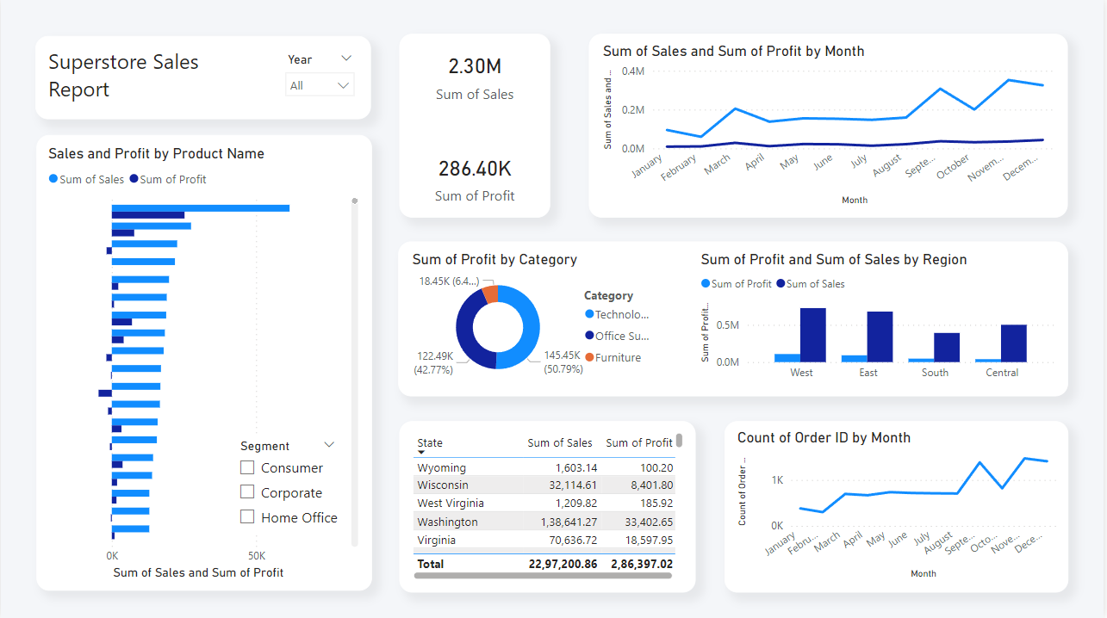
Superstore Sales
Report

